Slide 1
FORT ORD REUSE AUTHORITY
Board of Directors meeting
Capital Improvement Program – Phase II Study Formula Calculation Report
March 15, 2013
Presentation by Jonathan Garcia,
Senior Planner

Slide 2
Background (1)
Phase I of EPS’s work resulted in the Board adjusting the FORA CFD special tax/Development Fee Schedule (FORA Fee Program) by a 27% overall reduction
Phase II included the Board’s adoption of a formula (August 29, 2012) as a basis for future FORA Fee Program adjustments

Slide 3
Background (2)
EPS’s initial draft formula calculation in March 2013 (low scenario) was based on a development absorption schedule from the BRP Reassessment Market Study (assumes average of 180 residential units built each year thru 2020)
EPS’s subsequent sensitivity analysis (high scenario) was based on a development absorption schedule consistent with the FORA land use jurisdictions’ annual development forecasts (assumes average of 784 residential units built each year thru 2020)

Slide 4
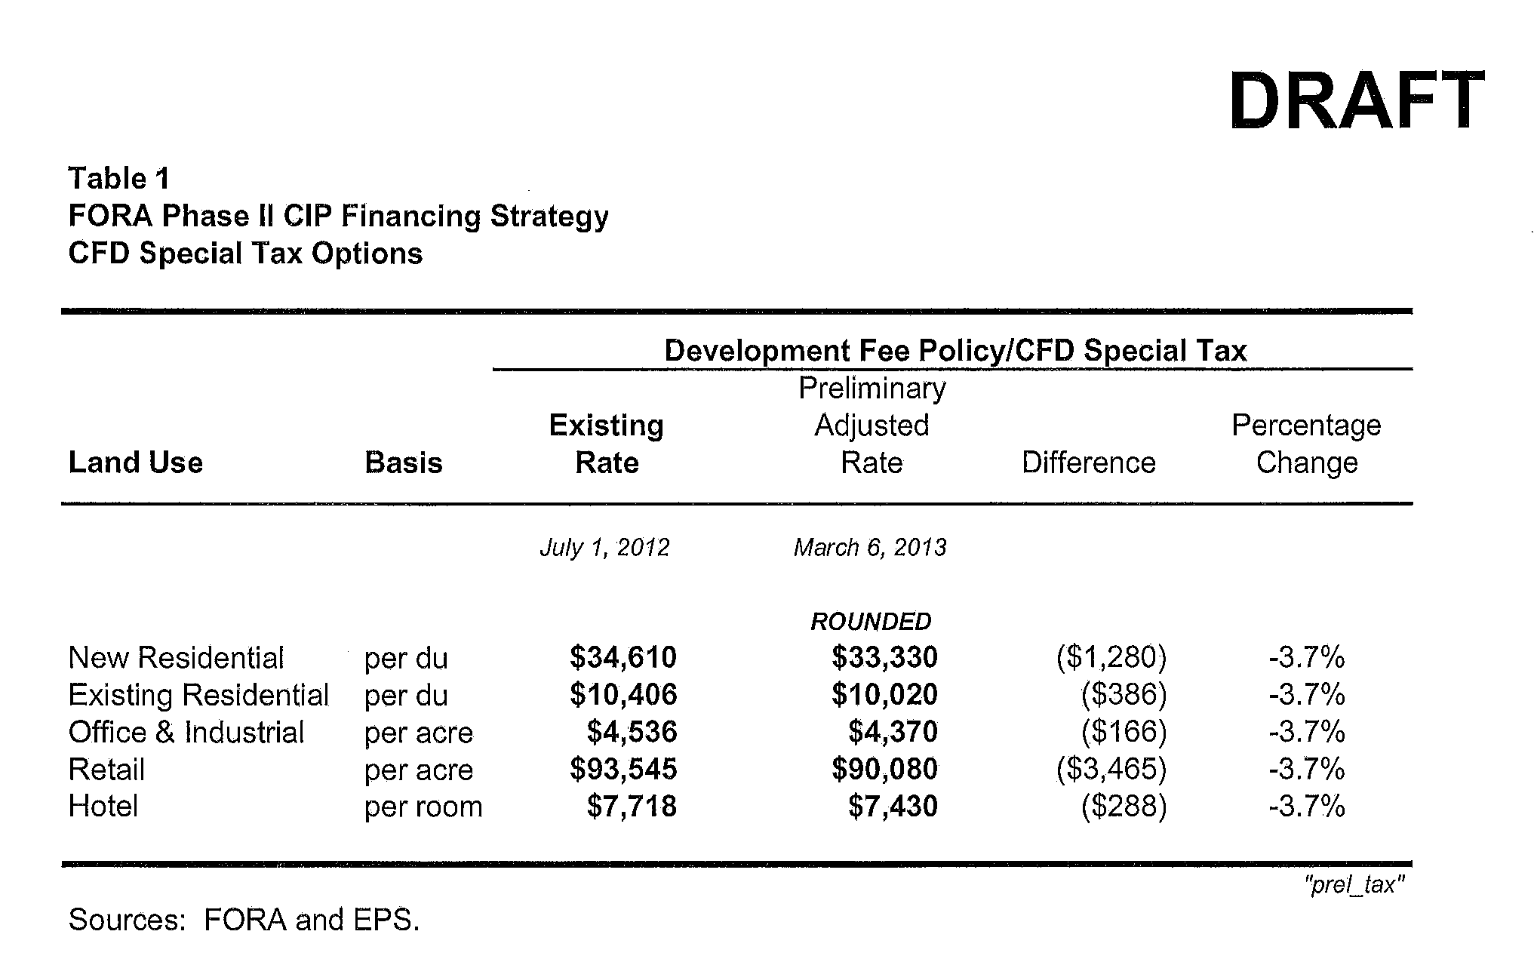
Draft formula results (low scenario)

Slide 5
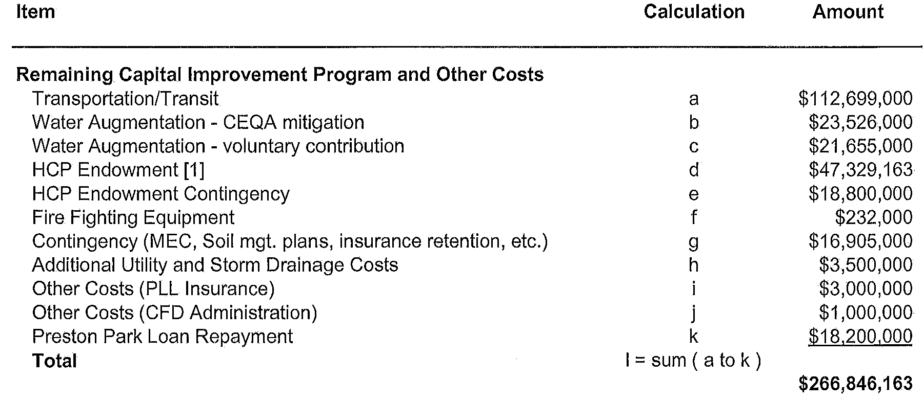
Draft Calculation (low scenario) 1 of 2

Slide 6
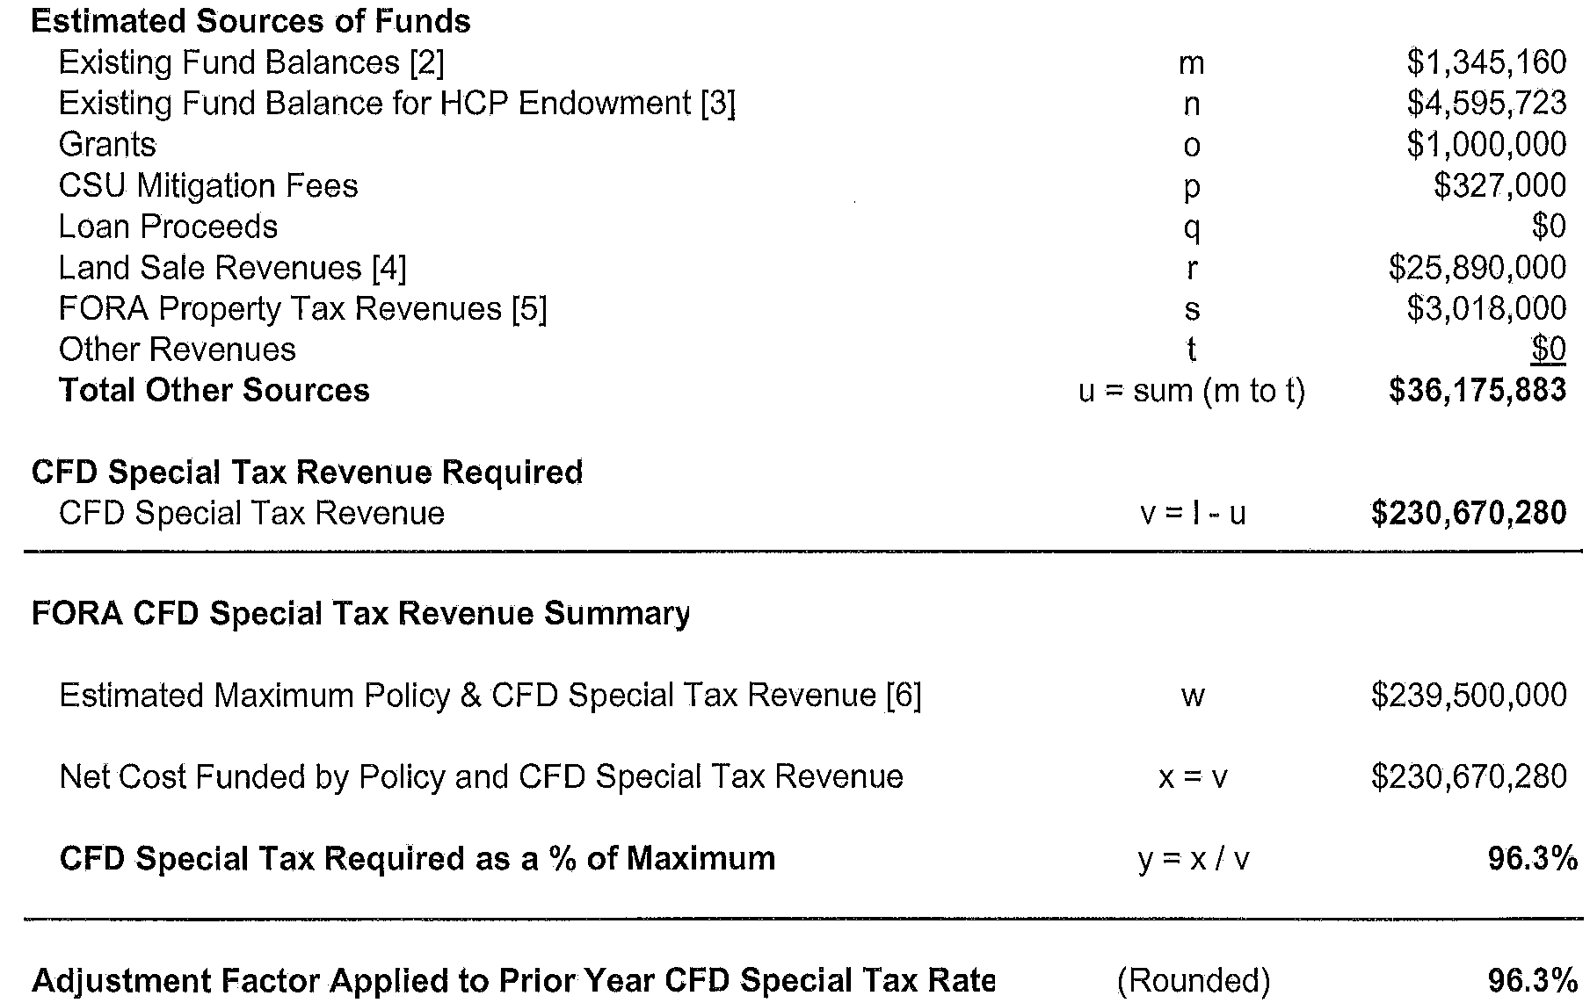
Draft Calculation (low scenario) 2 of 2

Slide 7
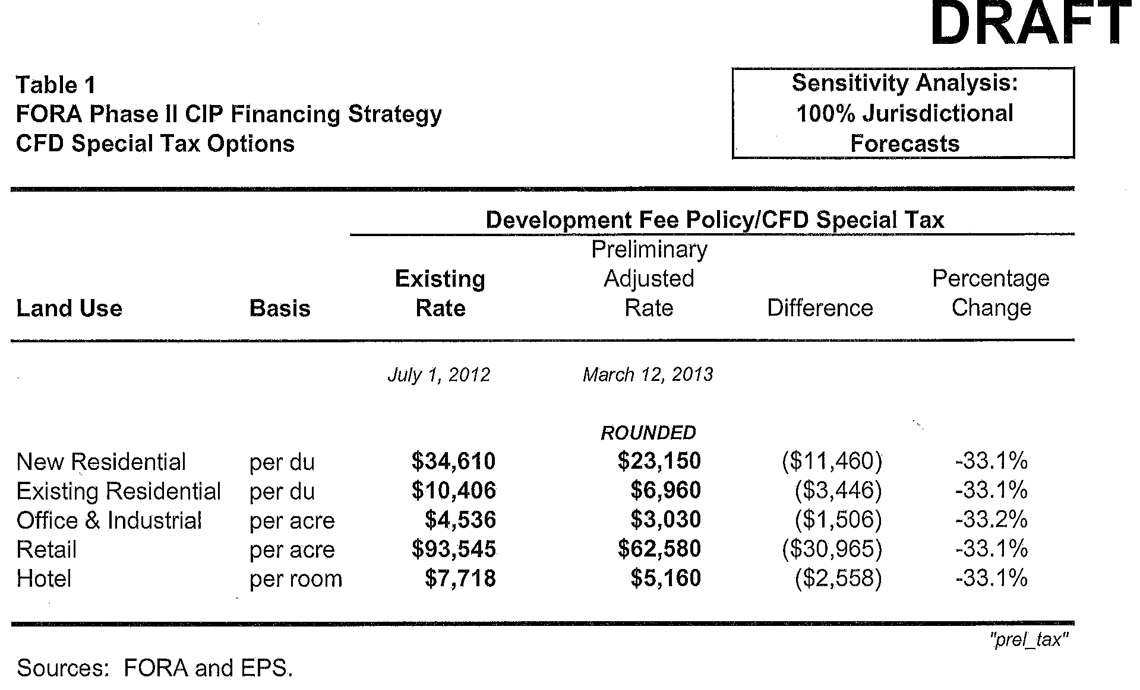
Draft formula results (high scenario)

Slide 8
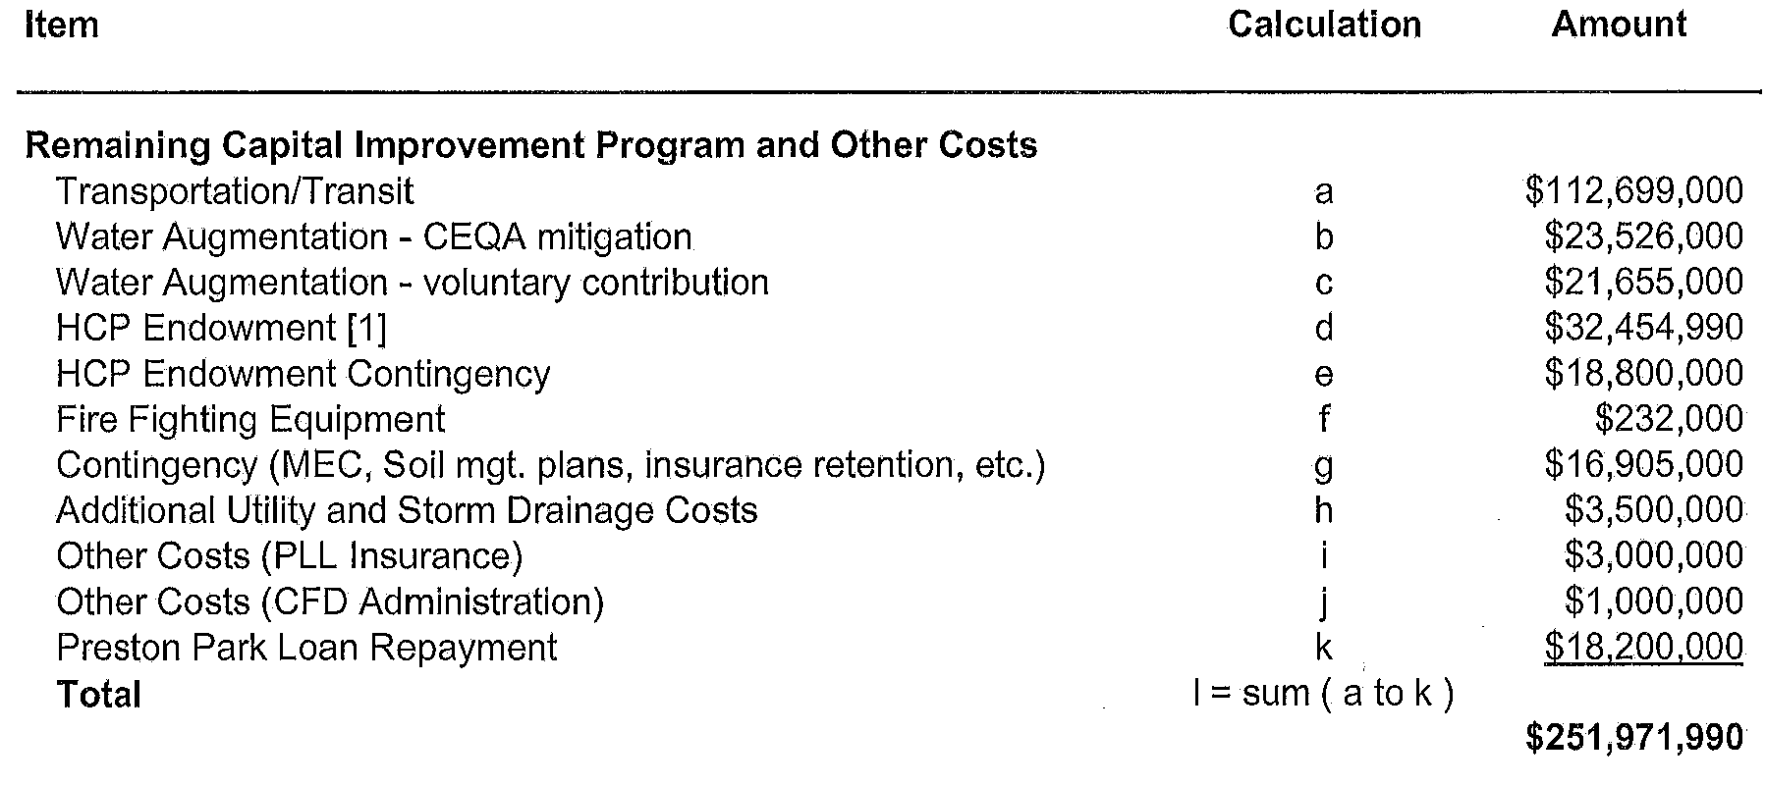
Draft Calculation (high scenario) 1 of 2

Slide 9
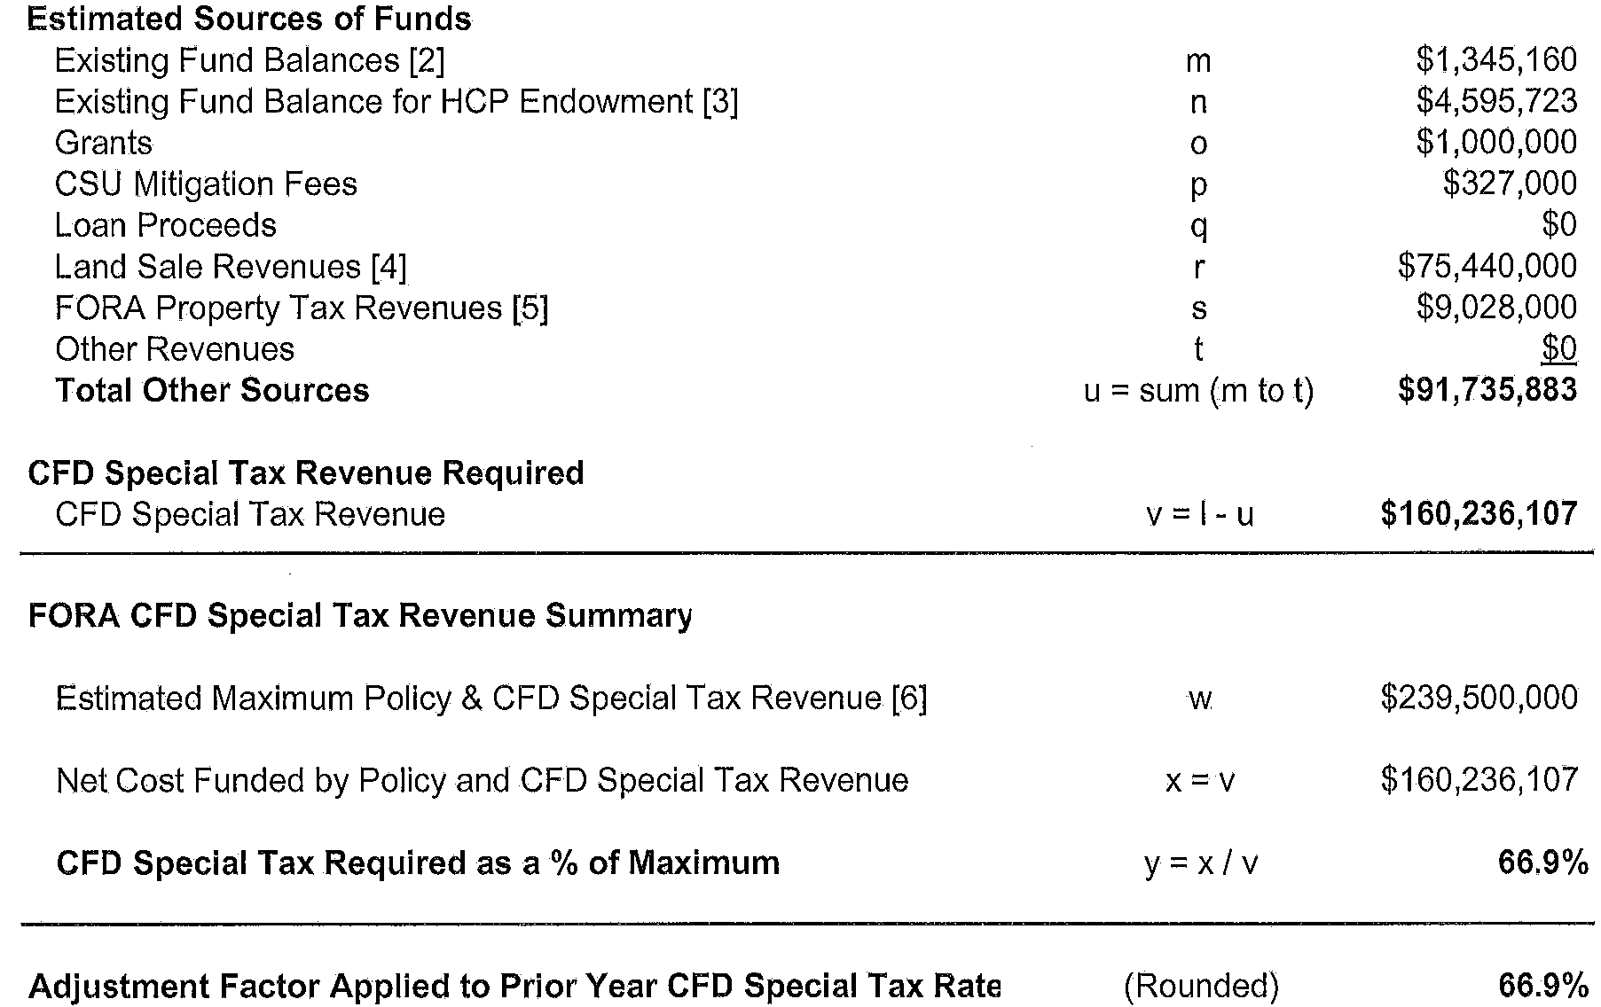
Draft Calculation (high scenario) 2 of 2

Slide 10
Questions
Questions from Board Members
Public Comment
Board Member Discussion

